Slide 1

Network Statistics
A Quick Overview

Slide 2
Simple Stuff
# nodes, # edges
Connected components: count of separate groups of nodes
Graph density: percent of possible links that are present

Slide 3
Degree Distribution
E.g., run “Average Degree” tab in Gephi.
For pure random networks:
For preferential attachment:

Slide 4
Path Length
E.g., run “Avg. Path Length” in Gephi
The path length between nodes i and j defined as
Average path length
Network diameter

Slide 5
Centrality
Betweenness centrality: number of shortest paths across node
Degree centrality (node degree), also edge centrality (not in Gephi)
Eigenvector centrality
Closeness

Slide 6
More Centrality
PageRank, like eigenvector centrality, can be written as an eigenvalue problem:

Slide 7

Clustering
Watts and Strogatz measure:
Newman (and Gephi):

Slide 8
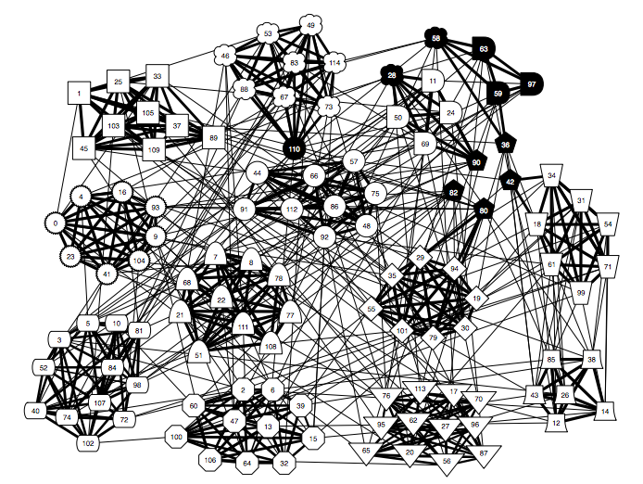
Modularity and Structure
From Clauset (2008)

Slide 9


